Slide 1
Superstore Analysis
by Isnaini Mufidhatul Mughni

Slide 2
Contents
Business and Data Understanding
Exploratory Data Analysis
Data Visualization
Conclusion and Recommendation

Slide 3
Business Understanding
SuperStore, an online home & office supply retailer operating in 48 states, faces increased market competition and seeks to improve its profits and profit margin.
Problem
Analytical Approach
The executive team would like to understand which products, subcategories & categories they should target or avoid.
Using the analysis is to understand sales patterns, identify areas for improvement, and provide strategic recommendations.

Slide 4
Data Understanding
Data Source: Kaggle
Order ID
Order Date
Ship Date
Customer
Manufactory
Product Name
Segment
Category
Region
Zip
City
State
Country
Discount
Profit
Quantity
Sales
Profit Margin

Slide 5
Dataset Definition

Slide 6
Data Understanding
There are 9,994 orders with 5,009 unique data points, which means that customers made transactions with different products or on different days. There are 793 unique customers, with William Brown being the customer who made the most purchases. The country is, of course, only the United States.
Product
Geographical Data
There are 3 segments, 3 categories, 17 subcategories, and 1,849 types of products. The most purchased product is the Staple Envelope, with 48 transactions.
The data consists of 4 regions, with the West region having the highest sales. There are 531 unique cities, with New York City having the most entries, and 49 states, with California having the highest sales.

Slide 7
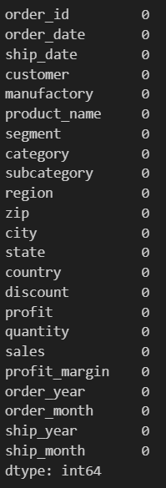
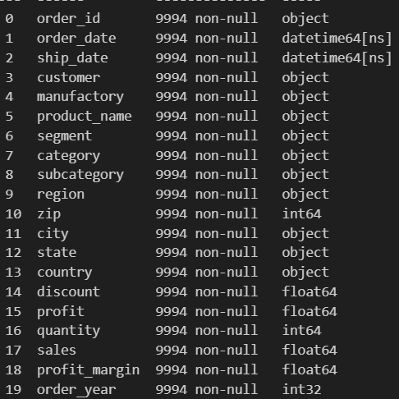
Data Cleaning & Preparation
0 Missing Values
Data Format
Handling missing data
Ensuring data format consistency

Slide 8
Exploratory Data Analysis & Visualization
Top Categorical Values
 | count | top | freq
order_id | 5009 | US-2023-100111 | 14
customer | 793 | William Brown | 37
manufactory | 182 | Other | 1893
product_name | 1849 | Staple envelope | 48
segment | 3 | Consumer | 5191
category | 3 | Office Supplies | 6026
subcategory | 17 | Binders | 1523
region | 4 | West | 3203
city | 531 | New York City | 915
state | 49 | California | 2001
country | 1 | United States | 9994
The order ID 'US-2023-100111' is the most recorded, but it belongs to Seth Vernon. However, the customer who made the most purchases is William Brown. This is because William Brown made many purchases with different order IDs, so he does not have the highest single order ID

Slide 9
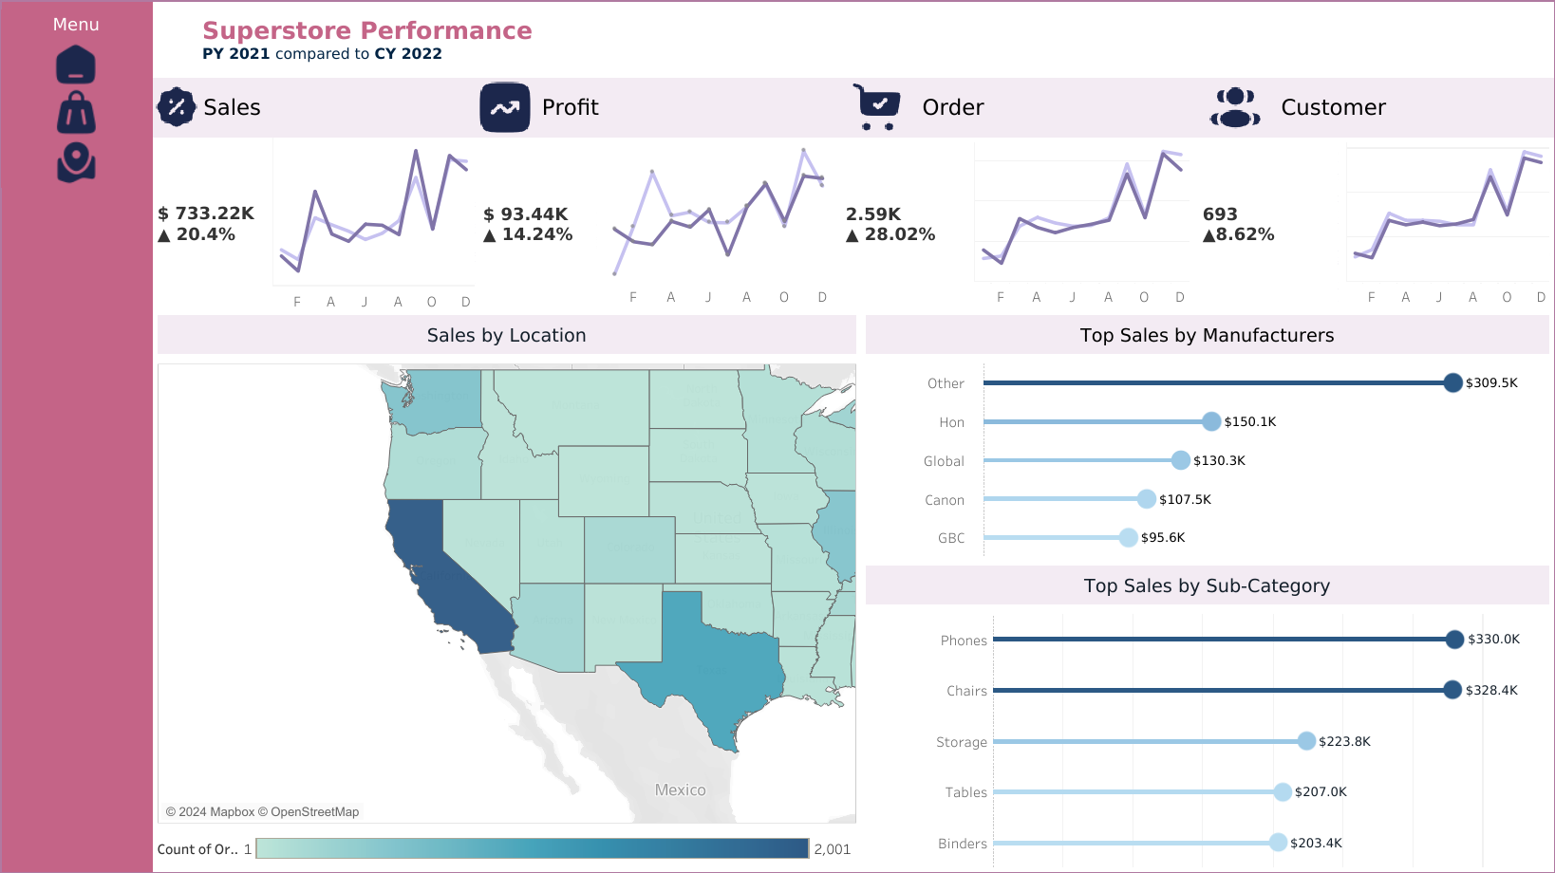
Data Visualization
Link Tableau

Slide 10
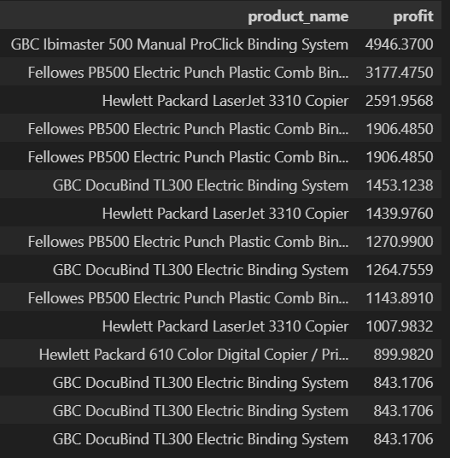
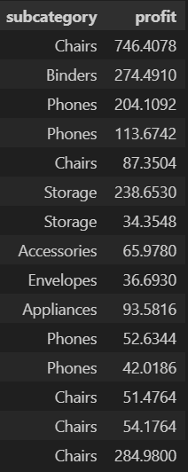

Product Analysis
Products with High Sales & Profits
Subcategory with High Sales & Profits
The calculation is done by finding the third quartile ($Q_{3}$) of the 'profit' data and the count of sales (value.count()) of the 'product' data. Then, the output result is sorted based on the profit.

Slide 11
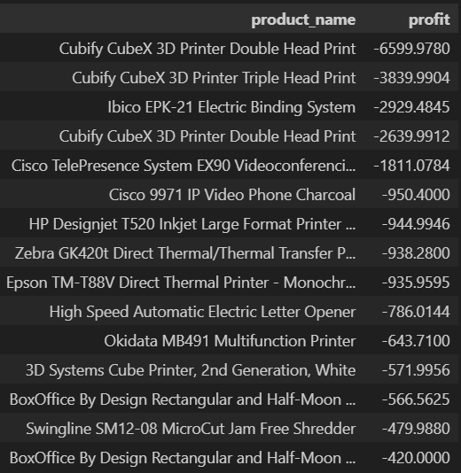
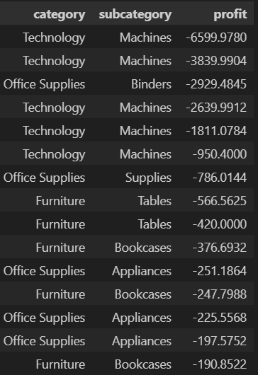

Product Analysis
Products with Low Sales & Profits
Subcategory with Low Sales & Profits
The calculation is done by finding the third quartile ($Q_{1}$) of the 'profit' data and the count of sales (value.count()) of the 'product' data. Then, the output result is sorted based on the profit.

Slide 13
Analisis Matriks BCG (Boston Consulting Group):
Stars: Produk dengan revenue tinggi dan volume penjualan tinggi.
Cash Cows: Produk dengan revenue tinggi tetapi volume penjualan rendah.
Question Marks: Produk dengan revenue rendah tetapi volume penjualan tinggi.
Dogs: Produk dengan revenue rendah dan volume penjualan rendah.

